Slide 1
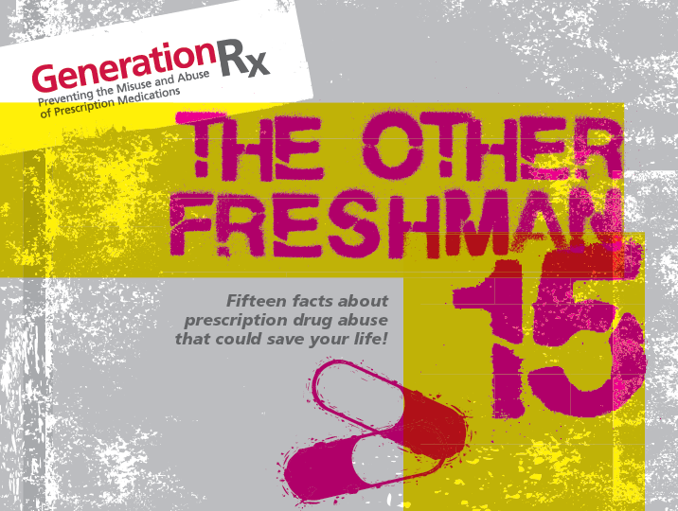
Notes:
College students are very aware of the infamous weight gain expected during their first-year, known as the “freshman fifteen.” This program will introduce “the other freshman fifteen” or 15 facts about prescription drug abuse that could save your life. Because, in addition to the expected weight gain, students are likely to encounter the opportunity to misuse or abuse prescription drugs while in college. So, we are here to raise awareness about the dangers of prescription drug abuse, which has the potential to derail your college career.

Slide 2

America’s biggest drug problem is the use of illicit “street” drugs.
Notes:
We will introduce these 15 facts by engaging the group in a discussion around six “fact or fiction” questions. So, let’s get started!
We all know that the abuse of illicit “street” drugs is a huge problem in our society, but is this America’s biggest drug problem -- fact or fiction?

Slide 3

America’s biggest drug problem is the use of
illicit “street” drugs.
Prescription medications are among the most
abused substances in
the United States!
Notes:
This is fiction! Based on data from the National Survey on Drug Use and Health (NSDUH, Substance Abuse and Mental Health Services Administration), we know that the abuse of prescription medications exceeds that for all illicit “street” drugs combined, except marijuana. If you combine data for the abuse of the different types of prescription drugs, it exceeds the abuse of marijuana. We also know that prescription and non-prescription medications constitute four of the top five abused substances by high school students, which contributes to the trends we are seeing in our colleges and universities.
So here is our first fact:
Prescription medications are among the most abused substances in the United States.

Slide 4
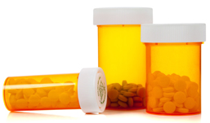
What types of prescription drugs are most commonly abused?
Notes:
What types of prescription drugs are most commonly abused? Any thoughts?

Slide 5
What types of prescription drugs are most commonly abused?
Painkillers (e.g., OxyContin®, Vicodin®)
Sedatives (e.g., Xanax®, Ativan®) Stimulants (e.g., Adderall®, Ritalin®)
Notes:
The three types of medications we are most concerned about in terms of abuse are painkillers, sedatives, and stimulants.
The opioid painkillers are often abused, can be very addicting, and are the single biggest culprits in overdose deaths. These include products like OxyContin®, Vicodin®, and Percocet®. Opioids are synthetic relatives of opiates, which are naturally occurring substances found in the opium poppy.
Sedatives, sometimes referred to as ”downers,” are medications like Xanax®, Ativan®, and Valium®.
Stimulants, sometimes referred to as “uppers” or “study drugs,” are medications like Adderall®, Ritalin®, and Concerta®. The abuse of this type of drug represents a major concern on our campuses, because the nonmedical use of these drugs among college students is more than twice as high as that among non-students who are 18-22 years of age (NSDUH). More than half of students who legitimately use a prescription stimulant under direction of their doctor have been asked to sell, trade, or give away their medication in the past year (National Council on Patient Information and Education).

Slide 6
College students are often at high risk for prescription drug abuse.
Notes:
Here’s our next “fact or fiction” question: Are college students at high risk for prescription drug abuse? Fact or fiction?

Slide 7

College students are often
at high risk for prescription drug abuse.
The average age when prescription drug abuse
starts is around 21.
Notes:
This one is a fact, because we know from the National Survey on Drug Use and Health that the average age when prescription drug abuse starts is around 21. This is why we are here to discuss these issues with you today, because we don’t want you to become part of this statistic.
On the other hand, we don’t want to give the impression that a majority of students are abusing these substances, because they are not. Students need to understand that it is not the norm on campus to abuse prescription medications for studying, partying, or self-medicating.
Here are our next three facts:
2) The average age when prescription drug abuse starts is around 21.
3) Non-medical use of prescription drugs by college students has doubled since the 1990’s.
4) About half of all college students will have the opportunity to abuse a prescription drug by their sophomore year.

Slide 8

Why do some college students choose to misuse or abuse prescription drugs?
Notes:
Why do you think college students sometimes misuse or abuse prescription medications?
There may be several reasons. For example, there are some prevailing misperceptions of safety and legality when abusing prescription medications, and students often have relatively easy access to these substances.
Perhaps one of the biggest factors is that you have grown up in a drug-taking society. We use more medications than any other country, we are one of only two countries (U.S. and New Zealand) that allow direct-to-consumer advertising of prescription drugs, we expect “quick fixes,” and all of this may tend to normalize the use of medications. This may also contribute to a phenomenon called “pharmaceutical populism,” which Greg Critser (Generation Rx: How Prescription Drugs are Altering American Lives, Minds, and Bodies) described as a growing campus culture of self-diagnosis and self-prescribing. Students may misuse medications in an attempt to manage their lives, often with very negative consequences.
Fact #5:
5) A growing campus culture of self-diagnosis and self-prescribing has the potential to cause negative health effects and lead to the dangers of prescription drug abuse.

Slide 9
Abusing prescription medications is a safer
and legal alternative to using illicit “street” drugs.
Notes:
Let’s explore some of these factors. How about prevailing perceptions of relative safety and legality when abusing prescription drugs – fact or fiction?

Slide 10
Abusing prescription medications
is a safer and legal alternative
to using illicit “street” drugs.
Using medications like Vicodin®, Xanax®, or Adderall® that
aren’t prescribed for you is
against the law, can have
serious health consequences,
and can be addicting.
Notes:
As you probably understand by now, this is clearly fiction.
Emergency department visits due to prescription drug abuse now exceeds that due to illicit “street” drugs; possessing medications like Vicodin®, Xanax®, and Adderall® without a prescription is a felony; and drug treatment center admissions due to prescription drug addiction has increased dramatically in recent years. In fact, the number of admissions to substance abuse centers involving prescription painkillers alone more than quadrupled between 1998 and 2009 (SAMHSA).
Mixing prescription drugs or taking them with illicit ”street” drugs or alcohol can be deadly, and here’s something else that college students often don’t think about – legal infractions such as those relating to the non-medical use of prescription drugs can come back to haunt you later in life, perhaps when you are applying for graduate school or for a job.
So, our next set of facts is:
Abusing prescription medications is not a safe alternative to using illicit “street” drugs.
Using medications like Vicodin®, Adderall®, or Xanax® that aren’t prescribed for you is against federal and state laws.
Emergency department visits relating to prescription drug abuse now exceed those relating to illicit “street” drugs.
Some prescription medications can be addicting.
10

Slide 11
Why do some people view the abuse of prescription medications and drugs like cocaine or heroin differently?
Notes:
Why do some people view the abuse of prescription medications and street drugs differently?
We have an inherently negative reaction to illicit “street” drugs like heroin, but since prescription medications are approved by the FDA and are legally prescribed by health professionals we often think of them as being safer. And if used under a health professional’s supervision this may be true. But, as we have seen, abusing medications can have a number of harmful health, legal, and social ramifications.

Slide 12
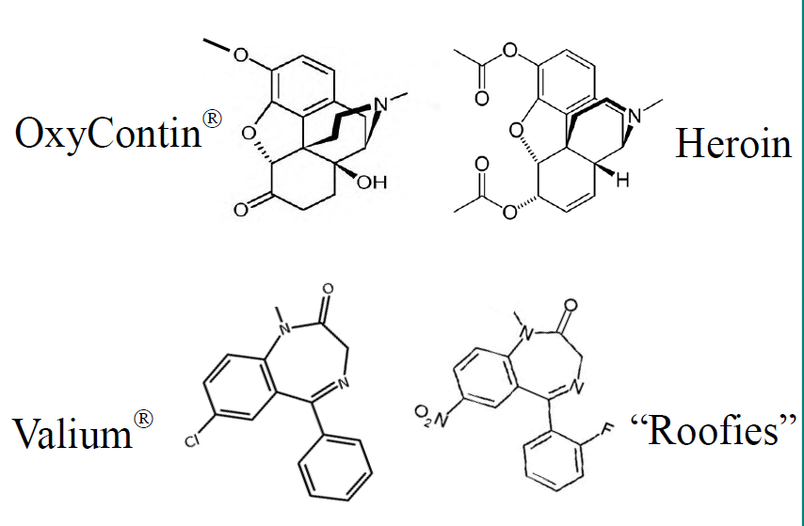
Why do some people view the abuse of prescription medications and drugs like cocaine or heroin differently?
They are more similar than you might think!
Notes:
And as this slide demonstrates, by virtue of their chemical structures and mechanisms of action in the body, prescription and street drugs are sometimes more similar than you might think.
12

Slide 13
More people die in the U.S. from unintentional drug overdoses than from
motor vehicle accidents.
Notes:
Fact or fiction?: More people die in the U.S. from unintentional drug overdoses than from motor vehicle accidents.

Slide 14
More people die in the U.S. from unintentional drug overdoses than from motor vehicle accidents.
On average, about
100 people die every day
from drug overdoses.
Notes:
Unfortunately, this is indeed a fact. Unintentional drug overdose is the leading cause of accidental death in the United States, with an average of 100 people dying everyday, according to the Centers for Disease Control and Prevention.
Fact #10:
10) Unintentional drug overdose is the leading cause of accidental death in the United States.

Slide 15
Most people who abuse prescription medications get them from a drug dealer.
Notes:
Most people who abuse prescription medication get them from a drug dealer – fact or fiction?

Slide 16
Most people who abuse prescription medications get them from a drug dealer.
More than 70% of those who abuse prescription medications get them from family members or friends.
Notes:
Fiction!
Access, due to the high quantity of these medications prescribed, is a key underlying contributor to this problem. In fact, the Centers for Disease Control & Prevention tell us that enough pain medications were prescribed in 2010 to medicate every American adult around-the-clock for a month. This enables the majority of prescription drug abusers to get them from family members or friends.
Facts #11:
Most people who abuse prescription medications get them from family members or friends.

Slide 17
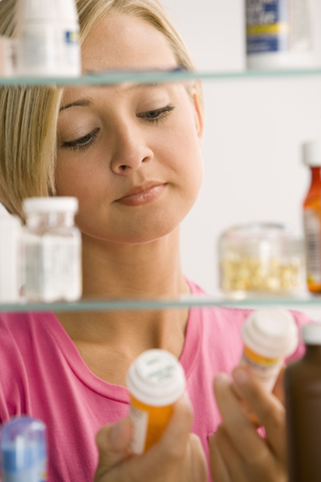
What can we do to prevent others from abusing our prescription medications?
Notes:
What can we do to prevent others from abusing our prescription medications?
First, simply don’t share your prescription medications with others. They were prescribed just for you and, as we have learned, others could actually be harmed by using them without medical supervision.
Two other things we must do is store our medications securely and properly dispose of medications when we no longer need them (see www.FDA.gov for safe disposal guidelines or participate in a drug take-back program in your community). These steps will help keep them out of the hands of potential abusers.
Fact #12:
12) It is critical that we store prescription medications securely and properly dispose of them when they are no longer needed to prevent misuse or abuse by others.

Slide 18
It is ok to share your prescription medications with others if they have a similar medical condition.
Notes:
We grow up learning that sharing is caring, so it must be ok to share your prescription medications with others if they have a similar medical condition – fact or fiction?

Slide 19
It is ok to share your prescription medications with others if they have a similar medical condition.
It is important to only use prescription medications
as prescribed for you by
a health professional.
Notes:
You guessed it – fiction!
We have to remember that there is a reason for the prescription. The Food and Drug Administration has decided that certain drugs are only safe if used under medical supervision. When we circumvent that protection, bad things can happen.
Another thing that college students seldom consider is the liability you may expose yourself to when sharing medications. If someone is hurt when you give them your prescription drugs, of course you would feel terrible, but you could also be liable for any harm experienced by the person to whom you provided the medication.
Facts 13 & 14:
It is important to only use prescription medications as prescribed by a healthcare professional.
When you share your prescription medications with others, you could be liable if that person is harmed.

Slide 20


Prescription drugs can help us live longer and healthier lives – but only if they
are used properly
under medical
supervision.
Notes:
Our final fact is a short summation of all that we have discussed previously:
15) Prescription drugs can help us live longer and healthier lives – but only if they are used properly under medical supervision.
Prescription drugs are very beneficial to our society. More and more, we are able to treat diseases that were previously incurable. In some cases, diseases that were once fatal are becoming chronic conditions due to these medications. Medications to treat diseases like AIDS and even some cancers have allowed countless people to live longer and healthier lives. But when misused or abused, prescription drugs can be harmful and even deadly.

Slide 21

For more information: go.osu.edu/generationrx cardinalhealth.com/generationrx
Notes:
We hope you have a fantastic college experience! Work hard, have fun, and stay well. Don’t let the abuse of prescription drugs derail your dream.
If you need help dealing with a prescription drug abuse issue:
Contact your college or university counseling, student health or wellness center.
Talk with your family, your doctor or pharmacist, academic advisor, or resident advisor.
The U.S. Substance Abuse and Mental Health Services Administration provides a searchable directory of drug and alcohol treatment programs, see http://findtreatment.samhsa.gov.
For a poisoning emergency (e.g., drug overdose) in the U.S. call 1-800-222-1222.
21

